Slide 1


Slide 2

Secure your cloud like a master. Deep dive into Azure Security Center
Viktorija Almazova
Cloudworks

Slide 3
Azure Security Center
Gain visibility and control into Azure infrastructure
Monitor security also for on-premises machines
Integrate 3rd party partner solutions
Detect attacks on resources deployed in the environment

Slide 4
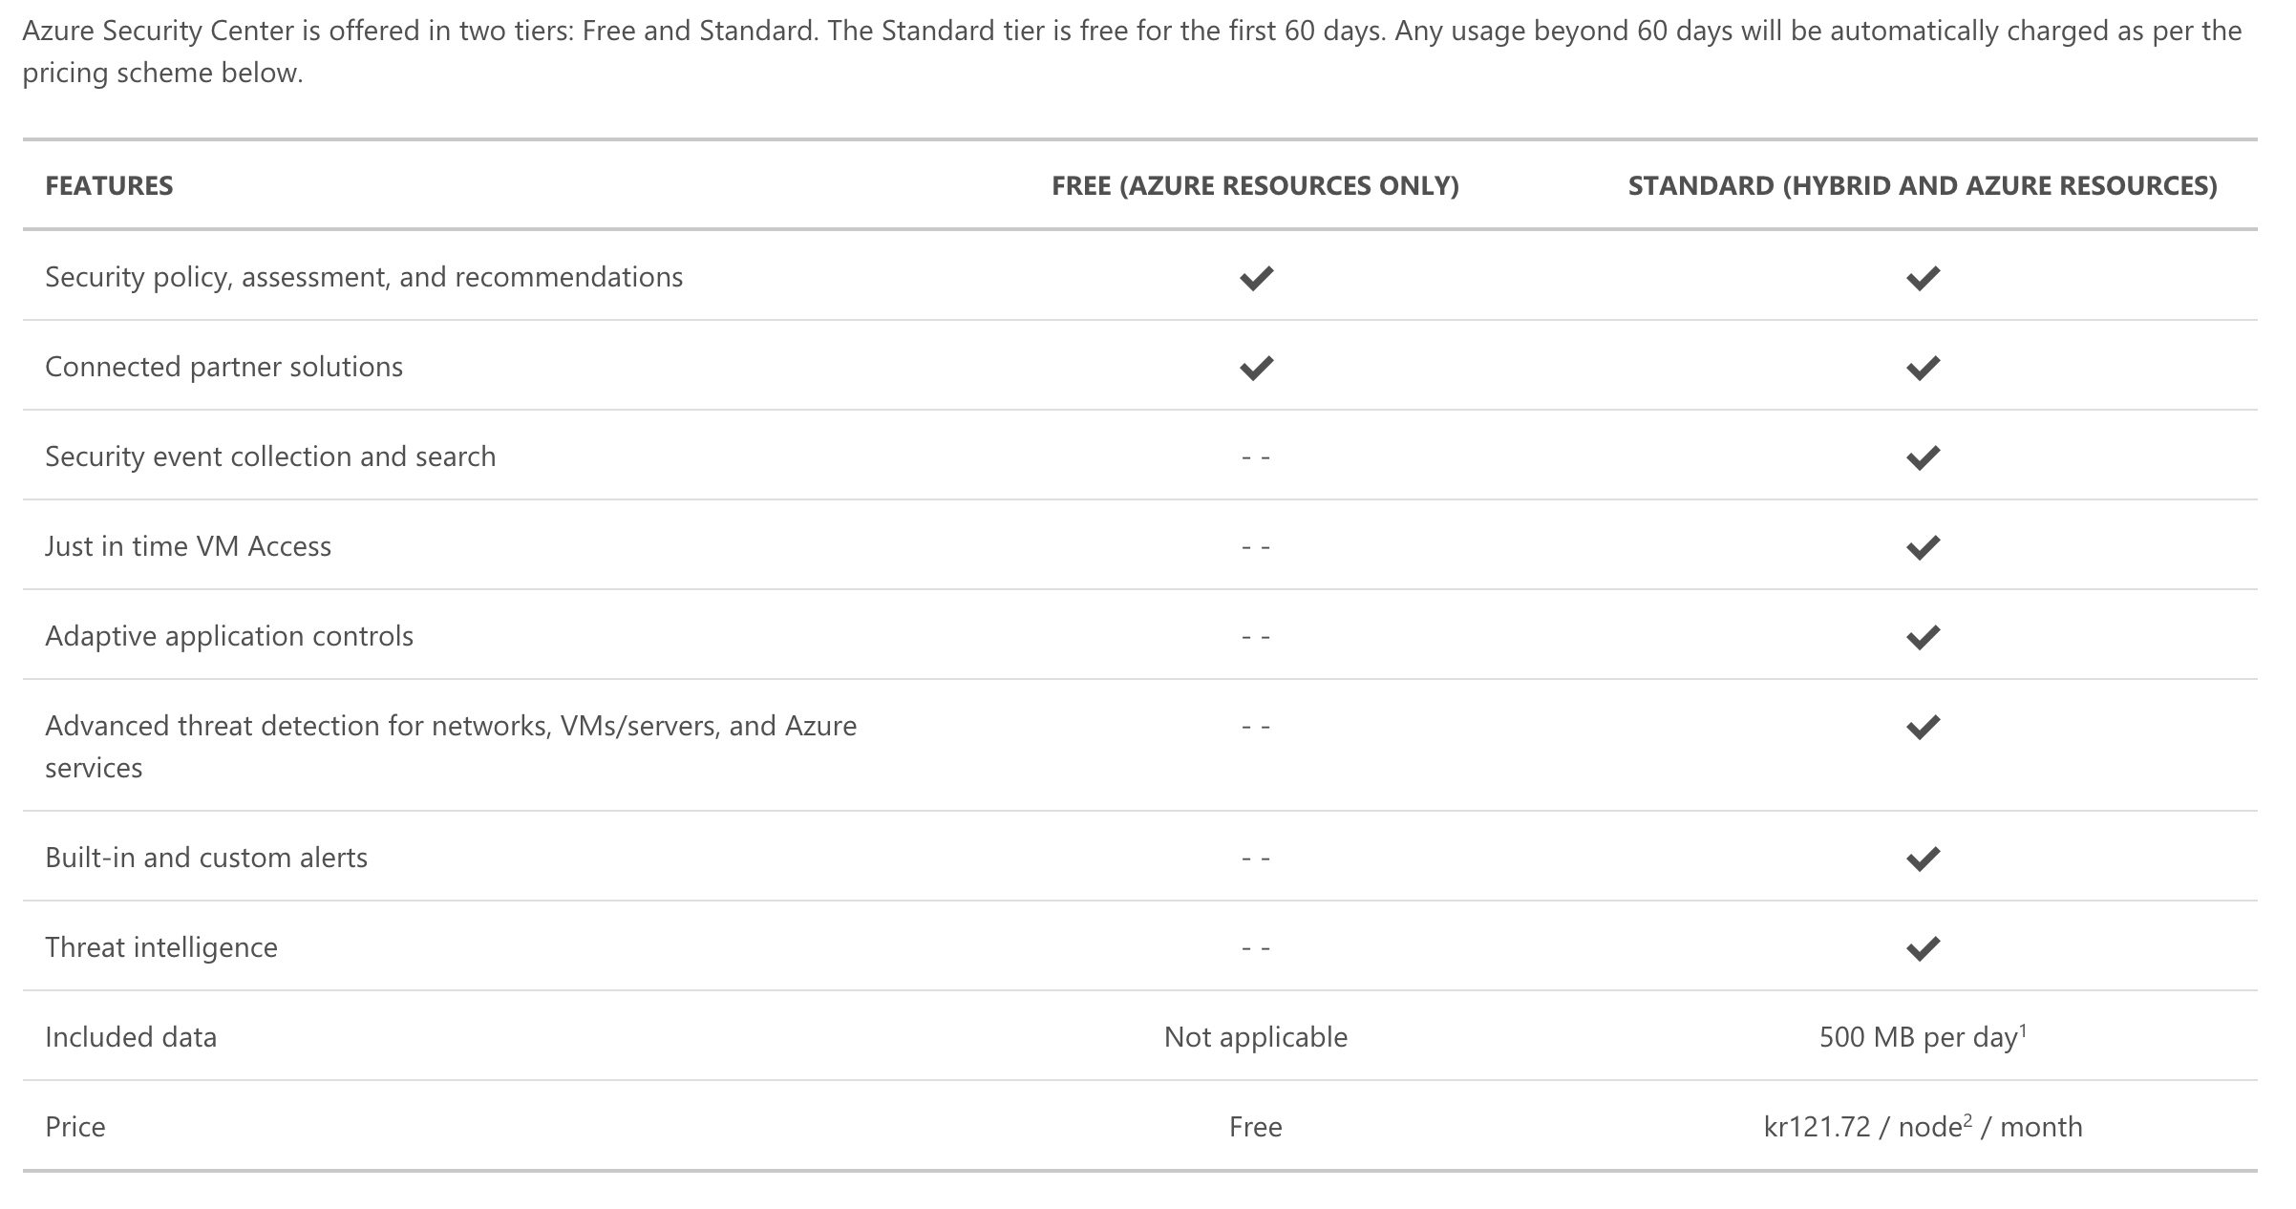
Azure Security Center: pricing

Slide 5
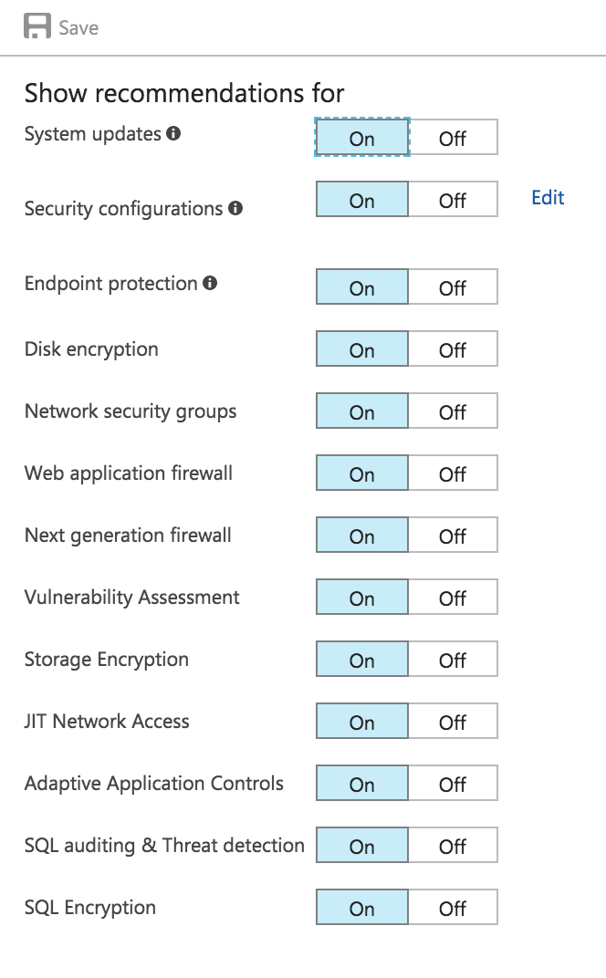
What we get
Security Center agent scans for various security related
configurations and events for machines:
Operating system type and version
Operating system logs (Windows event logs)
Running processes
Machine name
IP addresses
Logged in user
Tenant ID
Crash dump files

Slide 6
How data is stored.. Workspace
A workspace is an Azure resource that serves as a container for data
Might be used multiple workspaces to manage different sets of data that is collected from all or portions of IT infrastructure
Data collected from the Microsoft Monitoring Agent (on behalf of Azure Security Center) will be stored in either an existing Log Analytics workspace(s) associated with your Azure subscription or a new workspace(s), taking into account the Geo of the VM

Slide 7
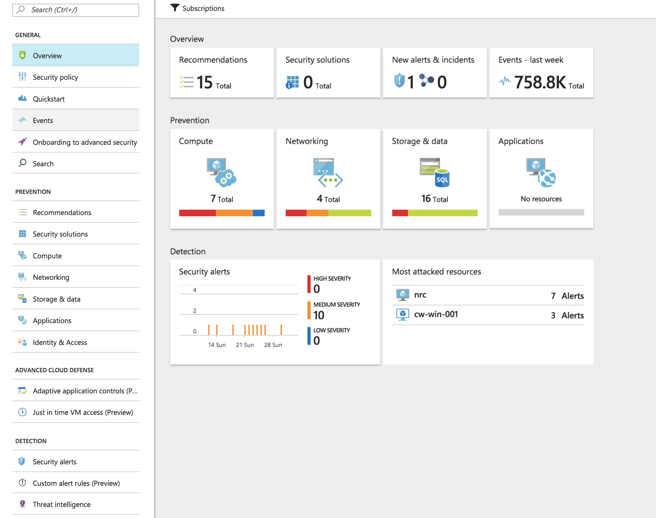

Slide 8

Demo
Azure Security Center Dashboard

Slide 9
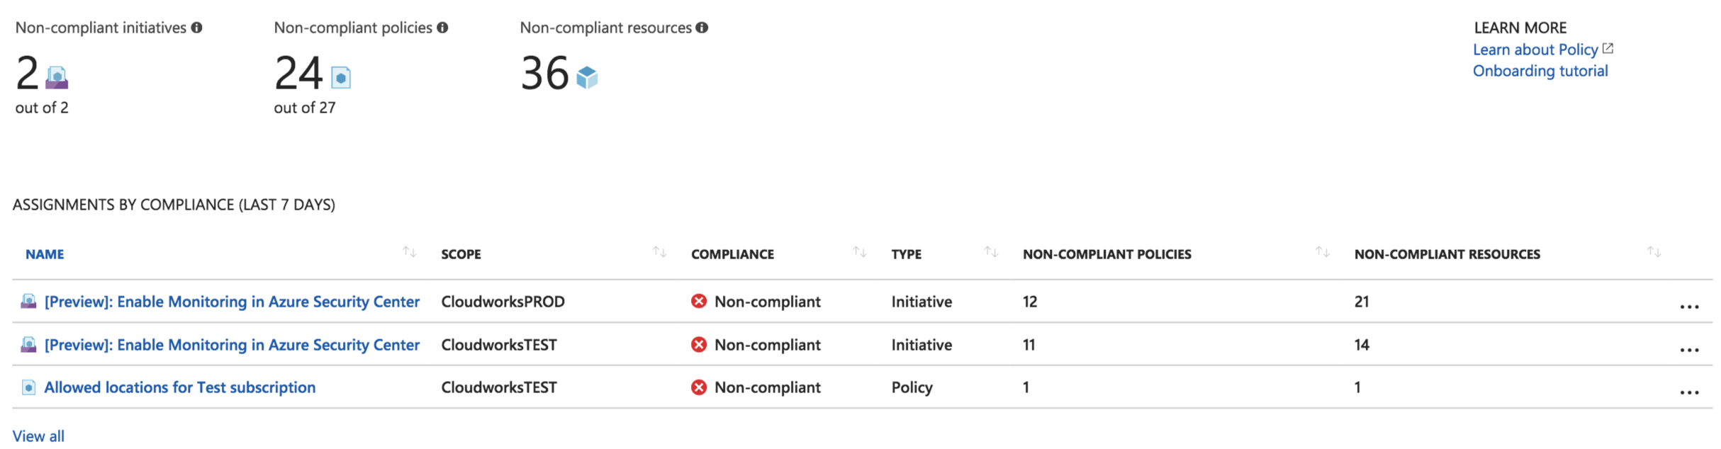
Azure Policy
Currently Private Preview
Allows to create, assign and, manage policy definitions
Policy definitions enforce different rules and actions over resources
Integrates with Security Center

Slide 10
Demo
Security Policies in Azure Security Center
Notes:
Policy and apply

Slide 11
Applying recommendations: Just in time
The just in time feature is in preview and available on the Standard tier
When just in time is enabled, Security Center locks down inbound traffic to Azure VMs by creating an NSG rule.
You select the ports on the VM to which inbound traffic will be locked down. These ports are controlled by the just in time solution.

Slide 12
Demo
Just in time

Slide 13
Applying recommendations: Adaptive Application Controls
The just in time feature is in preview and available on the Standard tier
Controls which applications can run on your VMs located in Azure
SC uses machine learning to analyze the processes running in the VM
SC relies on a minimum of two weeks of data in order to create a baseline
By default a new application control policy is always configured in Audit mode

Slide 14
Demo
Adaptive application controls

Slide 15
Detections capabilities
Threat intelligence
Looks for known malicious actors
Examples
Network traffic to malicious IP address
Malicious process executed
Behavioral analytics
Looks for known patterns and malicious behaviors
Examples
Process executed in a suspicious manner
Anomaly detection
Uses statistical profiling to build historical baselines
Alert on deviations that conform to a potential attack vector
Example
Remote desktop connections to a specific VM typically occur 5 times a day, today there were 100 connection attempts
Fusion
Combine events and alerts from across the kill chain to map the attack timeline
Examples
SQL injections (WAF + Azure SQL Logs)
Malicious process (Crash dump… and later… suspicious process execution)
Breach detection (Brute force attempt… and later… suspicious VM activity)

Slide 16
Demo
Security Incident

Slide 17
Creating Custom Alerts
In a preview
Custom alert rules in Security Center allows to define new security alerts based on data that is already collected from environment
You can create queries, and the result of these queries can be used as criteria for the custom rule, and once this criteria is matched, the rule is executed
You can use computers security events, partner's security solution logs or data ingested using APIs to create your custom queries

Slide 18
Demo
Custom security Incident

Slide 19
Threat Intelligence in Security Center
By using the threat intelligence option available in Security Center, IT administrators can identify security threats against the environment
Scenario: computers can become nodes in a botnet when attackers illicitly install malware that secretly connects the computer to the command and control. Threat intelligence can also identify potential threats coming from underground communication channels, such as the dark web

Slide 20
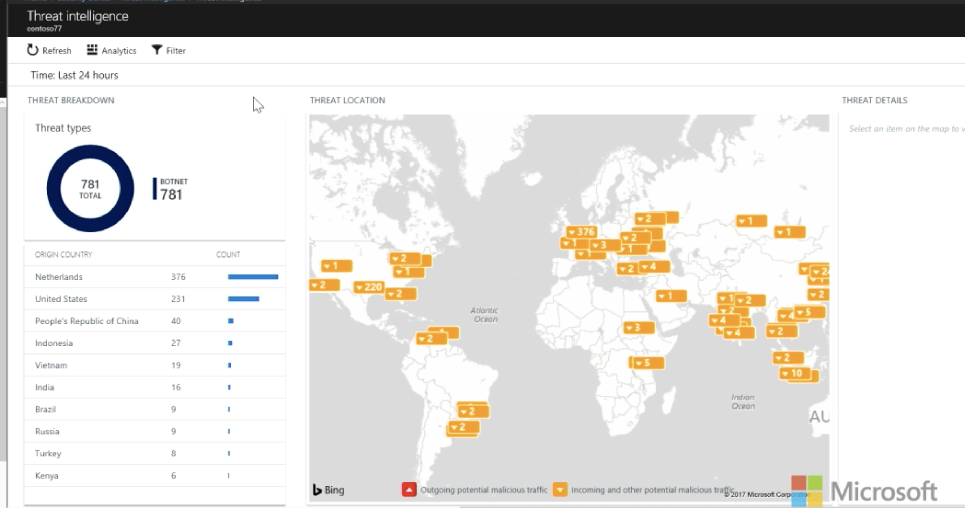
Demo
Azure Security Center Dashboard

Slide 21
Security Playbooks
Security playbook is a collection of procedures that can be executed from Security Center once a certain playbook is triggered from selected alert
Security playbook can help to automate and orchestrate your response to a specific security alert detected by Security Center. Security Playbooks in Security Center are based on Azure Logic Apps

Slide 22
Demo
Security Playbooks

Slide 23
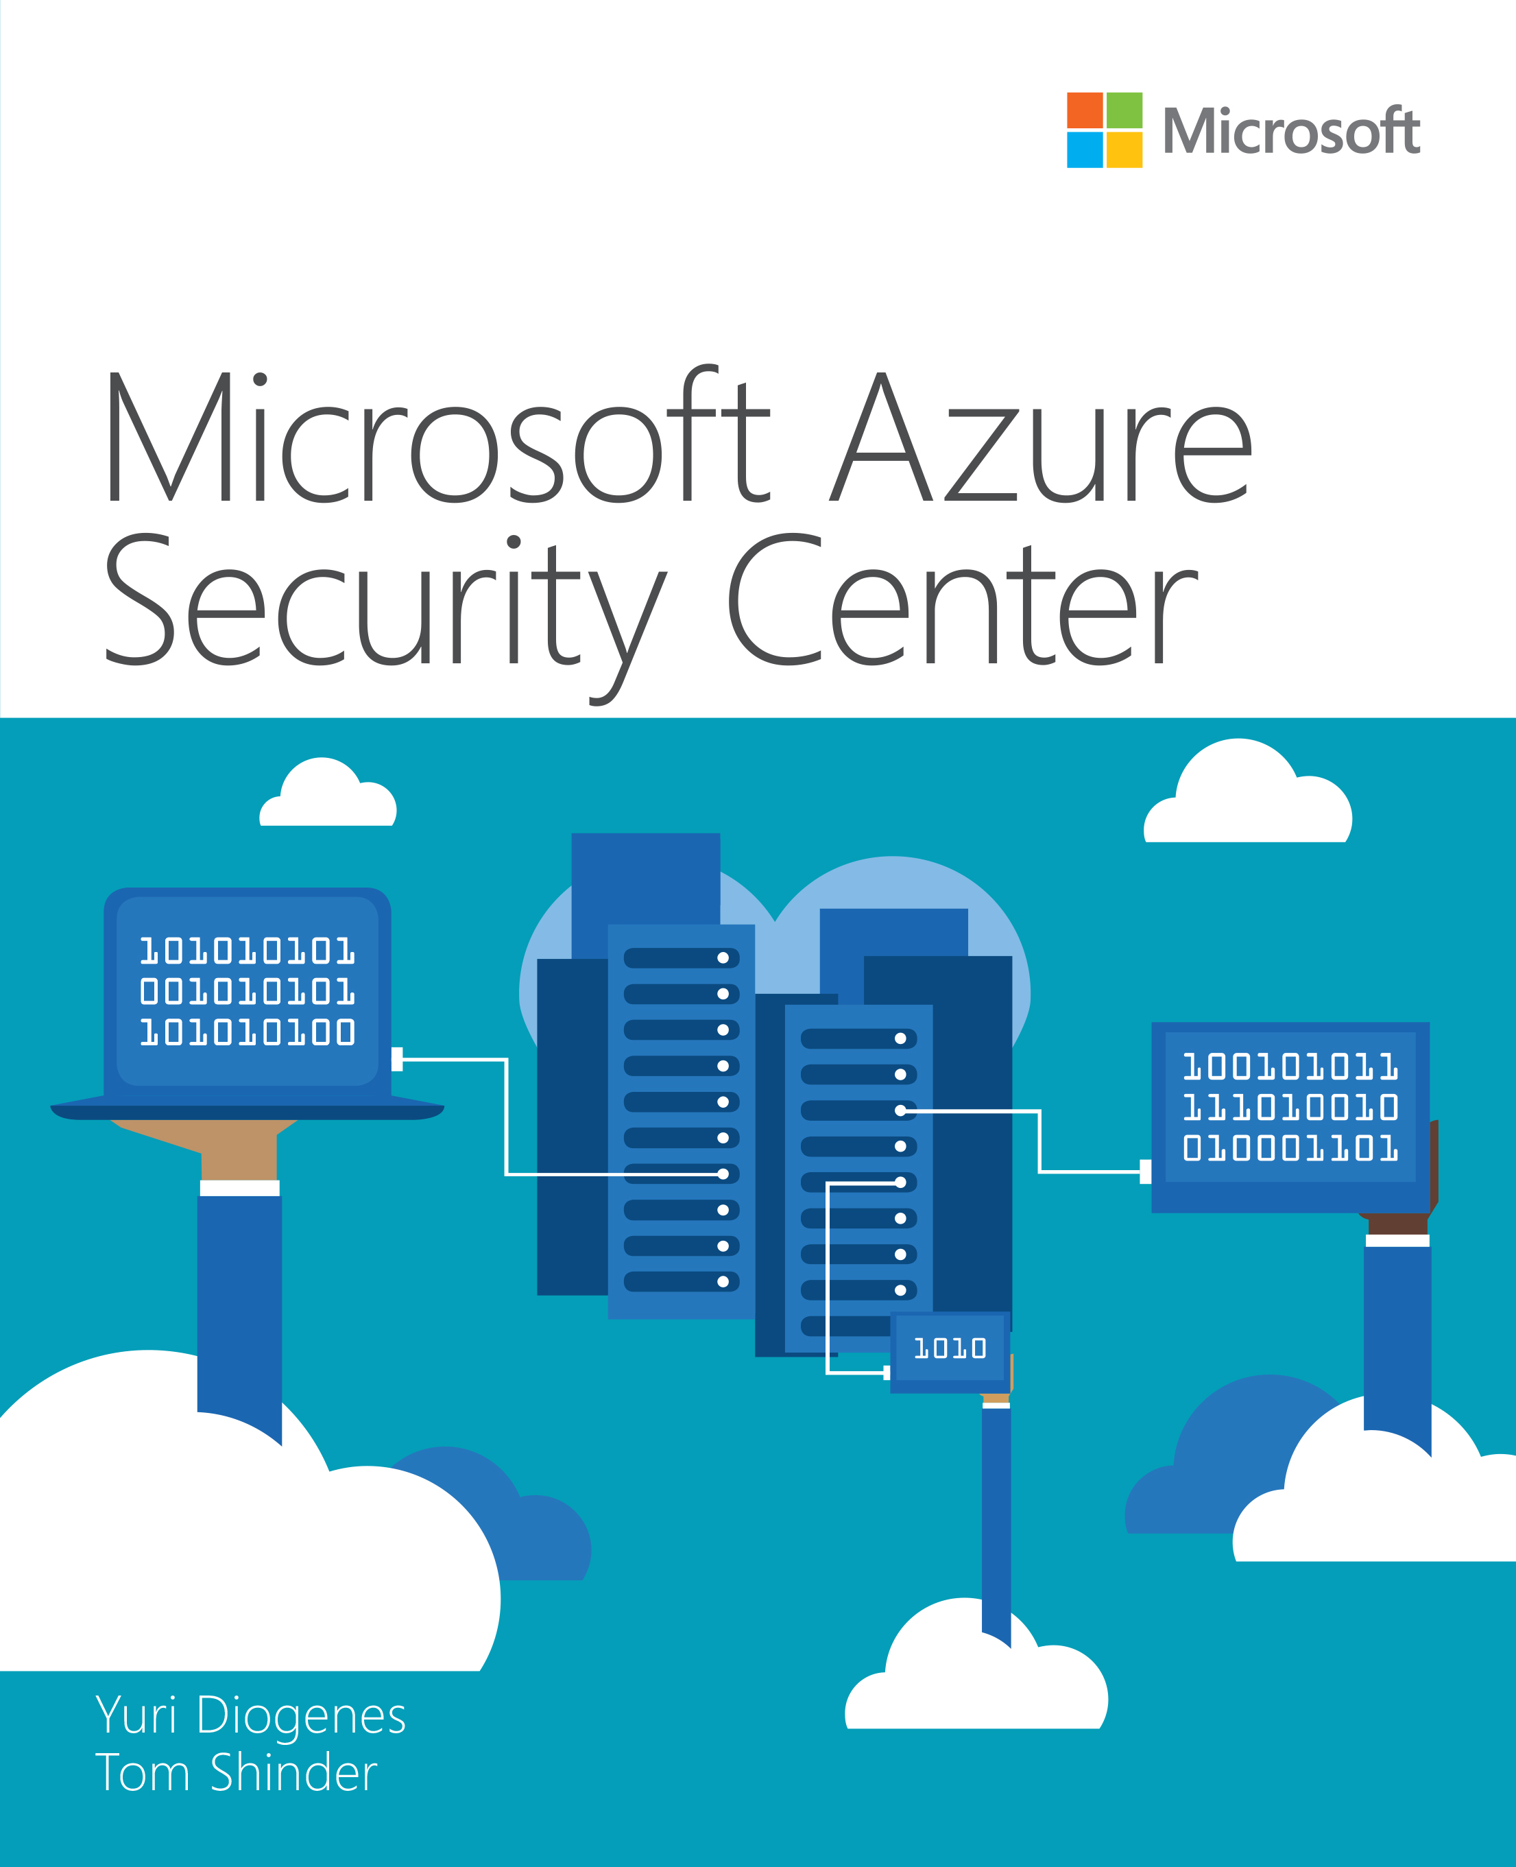
Thanks!

Slide 24
Resources
Slides and demos from the conference will be available at github.com/nordicinfrastructureconference/2018 (bit.ly/2y7JhA3)

